Slide 1
RUNGTA COLLEGE OF DENTAL SCIENCES & RESEARCH
TITLE OF THE TOPIC –PATIENT AND OPERATORS POSITION
DEPARTMENT OF CONSERVATIVE DENTISTRY AND ENDODONTICS

Slide 2
SPECIFIC LEARNING OBJECTIVES

Slide 3
Contents
Introduction
Definition
Workplace Intervention
Improving ergonomics in a dental set up
Conclusion
References

Slide 4
What is Ergonomics?
Introduction
“Ergo” means work
“Nomos” means natural laws or systems
Ergonomics is the science of work

Slide 5
Introduction
How you position yourself, your patient, how equipment is utilized, how the workplace is designed and how it impacts your health
ERGONOMICS is a way to work smarter, more efficiently with less effort and discomfort to the human body

Slide 6
Workplace Intervention
“Make the job fit the person” not vice versa
Minimize extreme joint position
Keep wrist in neutral (i.e., straight) position
Keep joints held at midpoint of range of motion
Reduce the use of excess force
Reduce highly repetitive movement

Slide 7
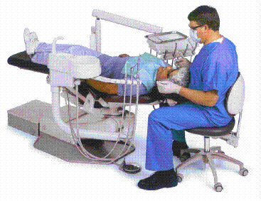
Ensure:
Instruments, materials, medications, etc. are accessible while seated
Hoses are positioned away from the body
Set-up can be adapted for different operators

Slide 8
Provide Sufficient Space
Awkward bending, twisting, and reaching places stress on the musculoskeletal system and can lead to discomfort.
Permanently place equipment used in every clinical procedure within comfortable reach (within 20 inches of the front of the body)
Use mobile carts for less commonly used equipment → Allows convenient positioning when required

Slide 9
Provide a clear line of sight to the oral cavity and all required equipment
Maintain a neutral, balanced position — position of an appendage when it is neither moved away from nor directed toward the body’s midline; it also should not be laterally turned or twisted

Slide 10
Accommodate Individual Preferences
Individuals vary in size, shape, training, and experience
Ensure equipment and work areas allow flexibility; examples may include:
Allows right- or left-handed use
Allows different working postures
Provides a choice in methods used

Slide 11
Dental Chair
The dental chair is the centre of all activity.
The first dental chair was manufactured by SS white dental company under the name “Harris”.
First hydraulic operated chair was manufactured in 1877 known as “Wilkinson’s chair”.
Modern reclining chairs were marketed from late 1960’s.

Slide 12
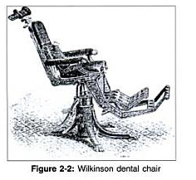
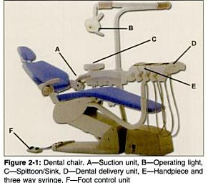

Slide 13
Dental chair should support entire patient’s body.
Chair should be able to move up, down, recline and incline and controls for which will be present either in foot control or on the side of the chair.
The dentist and the dental nurse need work surfaces around them on which to place instuments and materials.
The dental nurse needs facilities for mixing materials and the dentist needs an area for patient’s notes and a viewing box for radiographs.

Slide 14
Dental Chair
The dentist requies easy access to the handpieces and hand instruments.
These ( dental delivery units) may be situated on the dentist’s –
- side of the chair
- over the patient
- on the nurse’s side

Slide 15
Dental Chair
Usual dental delivery units consist of hand-pieces, scalers, suction units, electric moters, light cure unit etc.
Dental chair consists of a spittoon which may be used by the patient for washing the mouth and spitting, its usually found on the dental nurse side of the chair.

Slide 16
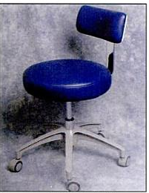
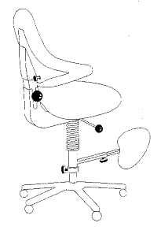
Operator’s stool
Goal: promote mobility and patient access; accommodate different body sizes
Look for:
Stability
Lumbar support
Hands-free seat height
adjustment
Fully adjustable

Slide 17
Should provide a broad, anatomically contoured seat and gives support to the lumbar region.
Adjusted to each in height to suit each individual operator in order to distribute the weight equally between thighs and feet.
The dental nurse’s chairs differs only, but importantly, in that it must adjust to at least a 10 cm increase in height and provide a corresponding bar stool type rim rest for the feet.

Slide 18
Operators need to know how to adjust the features of their chairs to obtain maximal ergonomic benefits.
Place feet flat on the floor and adjust the seat height up until thighs gently slope downward while the feet remain flat on floor.
This helps maintain the low back curve and enables you to position your knees under the patient more easily.
Move backrest up or down until the lumbar support nestles in the natural lumbar curve of the low back.
Then angle the lumbar support forward to facilitate contact with the low back.

Slide 19
Tilt the seat forward about five to 15 degrees. If you are beginning to work with the seat tilt function, start with a slight tilt and later increase the degree of tilt as is comfortable.
Adjust armrests, which are designed to decrease neck and shoulder fatigue and strain, to support elbows in the neutral shoulder position.

Slide 20
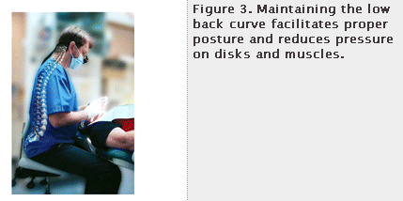

Slide 21
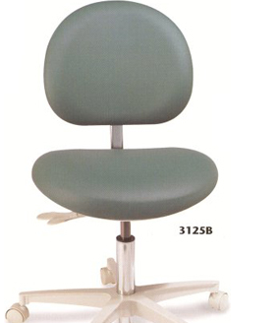
Advances in operator’s stool
Brewer’s DX3000 series
Adjustable backrest
18" wide polyfoam seat cushion
Pneumatic height adjustment 17"-24"
Dual adjustable lumbar backrest w/aseptic shroud
5-leg 24" diameter powder coated, cast aluminum base
Dual wheel casters with soft rubber thread
Seamless upholstery in a wide variety of colors
5-year warranty

Slide 22
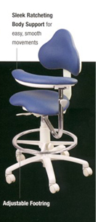

Slide 23
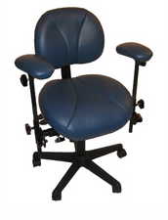
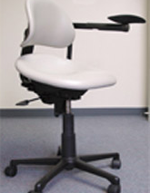
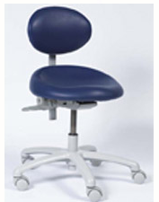
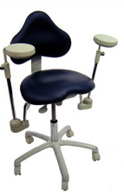
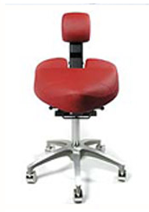
Dentech
Advance Chair
Orascoptic Bodyguard Chair
Swedish Seating System by RGP
Brewer 9100B Series Stool
Crown Seating 80 Series Dental Stool

Slide 24
OPERATOR SADDLE STOOLS
By increasing the hip angle, saddle stools allow the closest positioning to the patient, especially at the 8-9:00 positions.
Pelvic positioning helps reduce low back strain and, by design, the saddle stool facilitates use of the deep postural stabilizing muscles.
Excellent for small operatories, since they move around very easily.

Slide 25
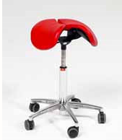
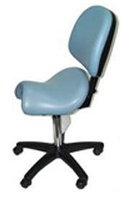
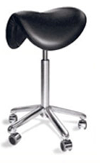
Salli Saddle Stool
Scandex Saddle Stool
Bambach Saddle Stool

Slide 26
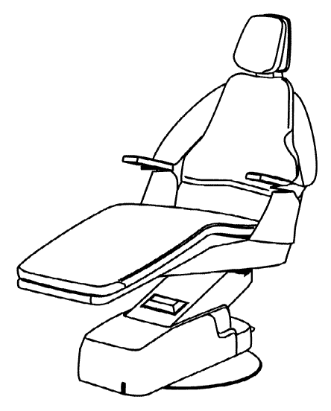
Patient Chair
Goal: promote patient comfort; maximize patient access
Look for:
Stability
Pivoting or drop-down
arm rests (for patient
ingress/egress)
Fully adjustable head rest
Hands-free operation
Thin head rests and back rests

Slide 27
Posture/Positioning
Goal: avoid static and/or awkward positions
Potential strategies
Position patient so that operator’s elbows are elevated no more than 30 degrees
Adjust patient chair when accessing different quadrants
Alternate between standing and sitting
Avoid twisting.

Slide 28
Work Practices
Goal: maintain neutral posture; reduce force requirements
Potential strategies
Ensure instruments are sharpened, well-maintained
Use automatic handpieces instead of manual instruments wherever possible
Use full-arm strokes rather than wrist strokes

Slide 29
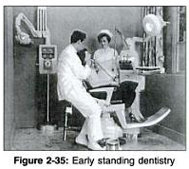
Earlier ,before 1950’s dentistry was practiced as standing dentistry.
With the advent of high speed handpieces in mid 1950’s,sitting dentistry was made popular.
It was in 1954 , Dr.Sanford S Golden an US army dentist called for the practice of sitting dentistry.

Slide 30
TAKE HOME MESSAGE
Serious detrimental physiological changes in the body can result from abnormal postures, including muscle imbalances, muscle necrosis, trigger points, hypomobile joints, nerve compression, and spinal disk herniation or degeneration. These changes often result in pain, injury or MSDs.
Preventing chronic pain in dentistry may require a paradigm shift within the profession regarding clinical work habits, including proper use of ergonomic equipment, frequent short stretch breaks and regular strengthening exercise.
Good ergonomic design of tools, processes and furniture DOES improve personnel comfort, health, morale, productivity and readiness.

Slide 31
QUESTIONS
WHAT IS OPERATORS STOOL ?

Slide 32
References
The Journal of the American Dental Association December 1, 2003vol. 134 no. 12 1604-1612.
The Journal of Calif. Dent assoc. 1996 and 2002
Textbook of operative dentistry : Marzouk
Principles of operative dentistry : A. J. E. Qualtrough, Julian Satterthwaite, Leean Morrow, Paul Brunton
Essentials of Operative Dentistry : I. Anand Sherwood, Ph.D., L. Lakshmi (FRW) Narayanan
www.google.com

Slide 33
Thank You !!!

